Slide 1
NCP189 / NCV8189 / NCP59801 / NCV59801
Technical presentation
Marek Bek, PO BU, Roznov CzDC
September 2022

Slide 2
NCP189 / NCV8189 / NCx59801 – main features
High precision (0.7% at room temp, 1% up to +125°C)
Operation up to +150°C (NCV automotive versions)
Very low dropout (65mV @ 0.5A, 130mV @1A)
Controlled output voltage slew rate (typ. 5mV/us, 10mV/us, 30mV/us or 100mV/us)
Minimum input voltage 1.6V (range up to 5.5V)
Wide output voltage range from 0.6V to 5V
Adjustable option available (reference voltage 0.6V)
Low power consumption 35uA
Low noise 10uVrms
Power Good signal functionality
Stable with 4.7uF MLCC output capacitor

Slide 3
NCP189 / NCV8189 / NCx59801 – main features (cont.)
Voltage options are trimmed at FT, easy way to provide new options on demand
Output voltage options with 50mV step available on demand
Precise current limit stable over temperature (can be trimmed to different levels)
Packages with very good thermal parameters (2x2mm and 3x3mm)
Demo boards already available

Slide 4
NCP189 / NCV8189 vs. competitor
Direct competitive part is TPS745 (0.5A)
NCP189 / NCV8189 has significantly better dropout (65mV vs. 95mV)
NCP189 / NCV8189 has significantly better noise (10uVrms vs. 53uVrms)
Both have the same pinout
Both have the same accuracy
Both have similar package thermal parameters
TPS745 has wider input operating voltage range (1.5V to 6V)
TPS745 adjustable has reference voltage 0.55V

Slide 5
NCP59801 / NCV59801 vs. competitor
Direct competitive part is TPS746 (1A)
NCx59801 has significantly better dropout (130mV vs. 160mV)
NCx59801 has significantly better noise (10uVrms vs. 53uVrms)
NCx59801 has better accuracy (0.7% vs. 0.85% at room, 1% vs. 1.5% in range up to +125°C)
Both have the same pinout
Both have similar package thermal parameters
TPS745 has wider input operating voltage range (1.5V to 6V)
TPS745 adjustable has reference voltage 0.55V

Slide 6
NCP189 / NCV8189 / NCx59801 – application hints
FB / SNS pin must be connected to OUT directly (fixed option) or through resistor divider (adjustable option)
Output voltage slew rate is given internally, no external component is required
Feed forward capacitor is not required
PG pin can be connected through pull-up resistor to OUT, IN or any other voltage less than 6V
If not used, PG pin can be left NC or connected to GND
Minimal recommended output capacitor is 4.7uF, maximal ~100uF. Outside these range it may be unstable under some conditions
Typical application schematic:

Slide 7
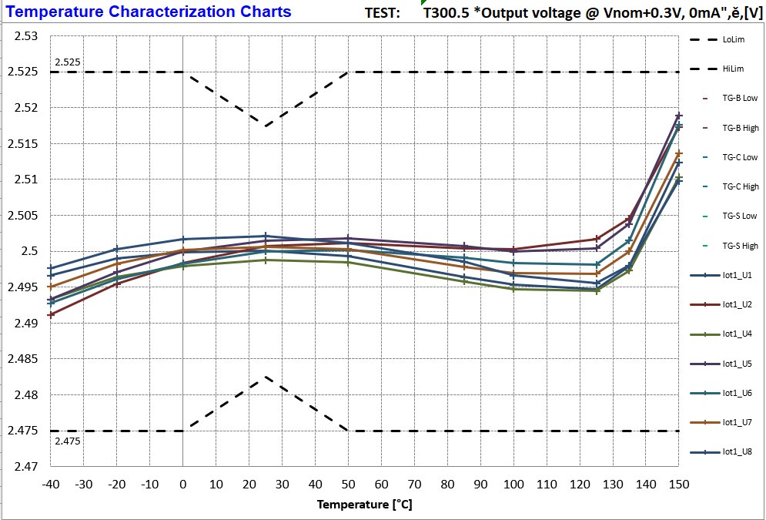
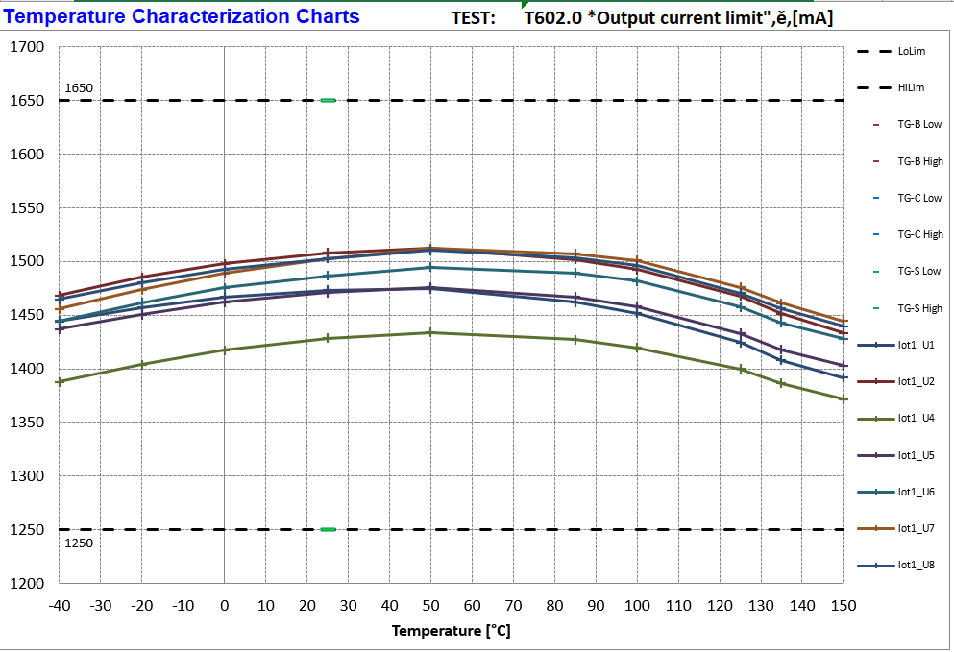
NCP189 / NCV8189 / NCx59801 – highlights
Output voltage accuracy over temperature
Current limit accuracy over temperature

Slide 8
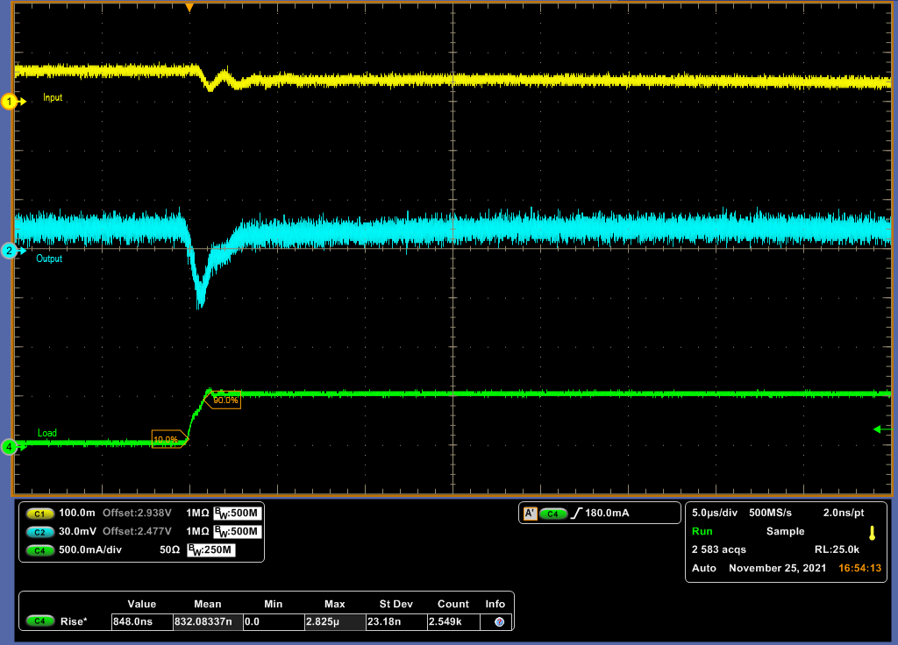
NCP189 / NCV8189 / NCx59801 - load transients
Option: 2V5
1mA to 500mA
Cout = 4.7uF
Ta = -40°C

Slide 9
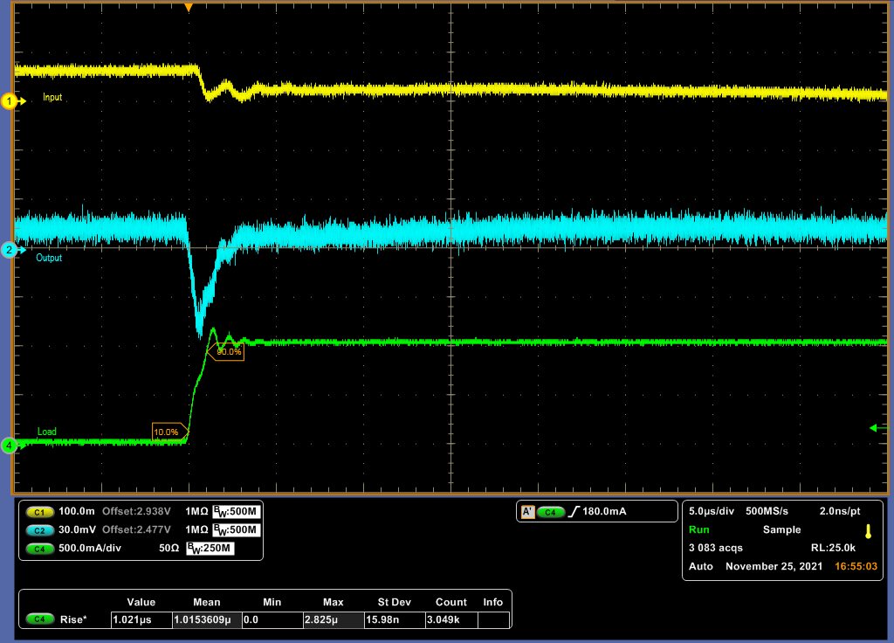
NCP189 / NCV8189 / NCx59801 - load transients
Option: 2V5
1mA to 1000mA
Cout = 4.7uF
Ta = -40°C

Slide 10
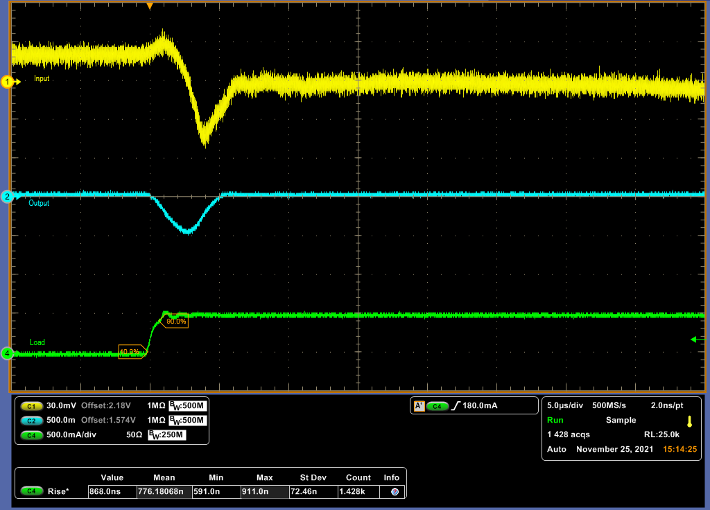
NCP189 / NCV8189 / NCx59801 - load transients
Option: 1V6
0mA to 500mA
Cout = 4.7uF
Ta = 25°C

Slide 11
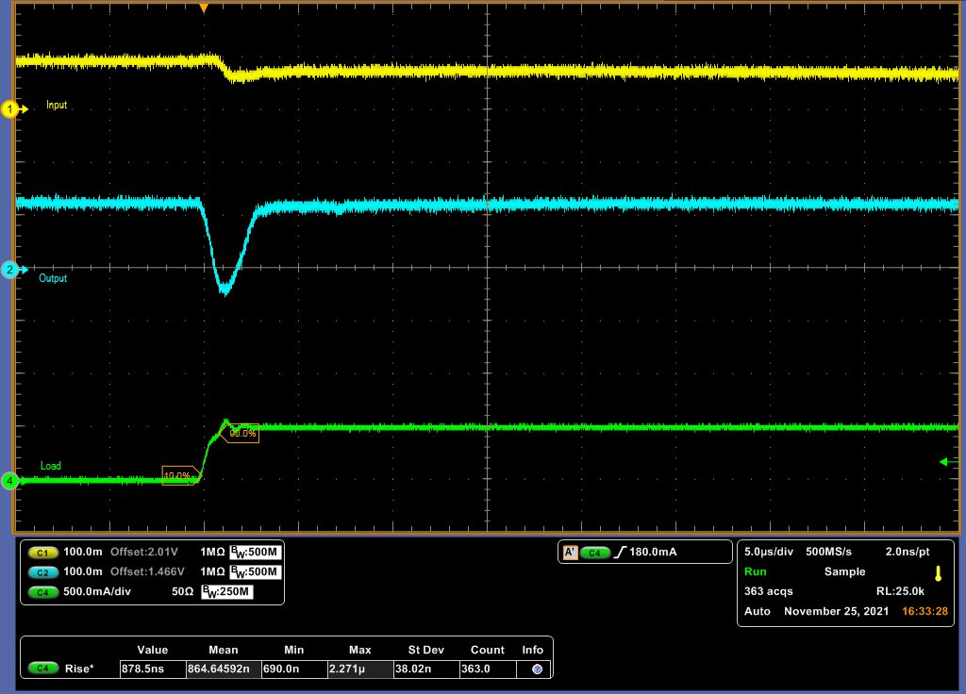
NCP189 / NCV8189 / NCx59801 - load transients
Option: 1V6
0mA to 500mA
Cout = 4.7uF
Ta = -40°C

Slide 12
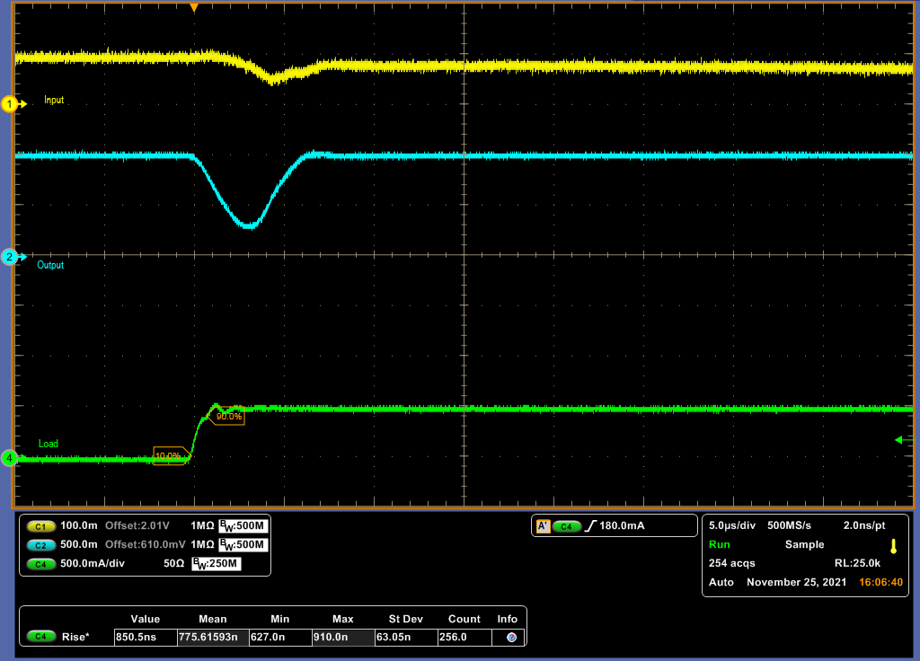
NCP189 / NCV8189 / NCx59801 - load transients
Option: 1V6
0mA to 500mA
Cout = 4.7uF
Ta = 150°C

Slide 13
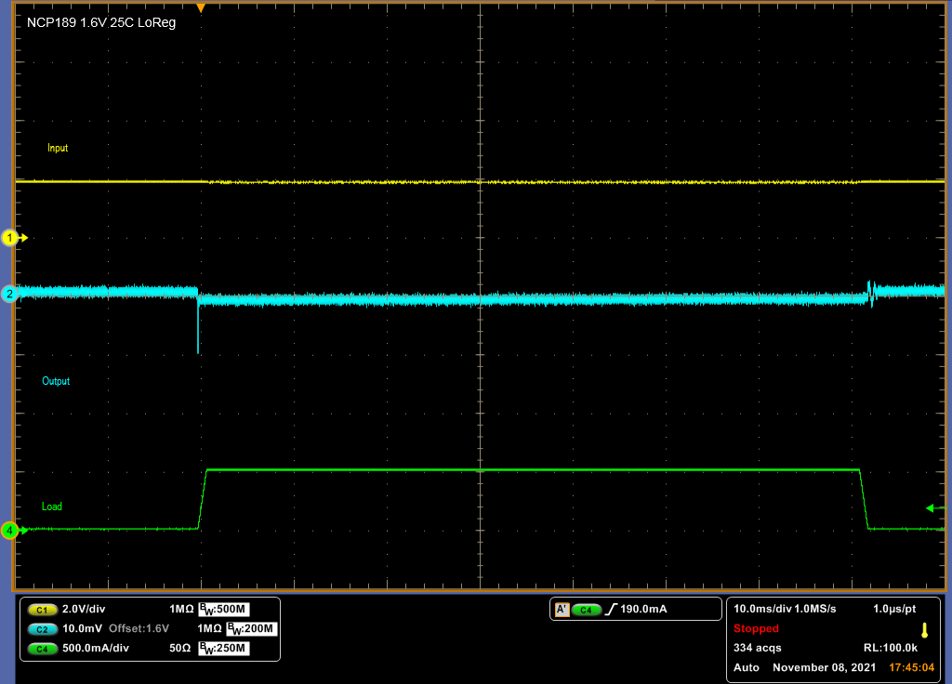
NCP189 / NCV8189 / NCx59801 - load regulation
Option: 1V6
0mA to 500mA
Cout = 4.7uF
Ta = 25°C

Slide 14
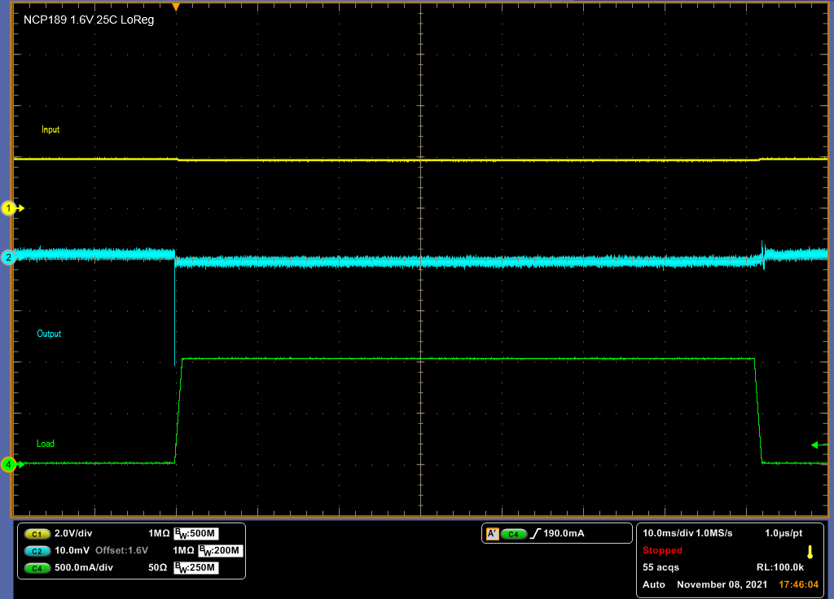
NCP189 / NCV8189 / NCx59801 - load regulation
Option: 1V6
0mA to 1000mA
Cout = 4.7uF
Ta = 25°C

Slide 15
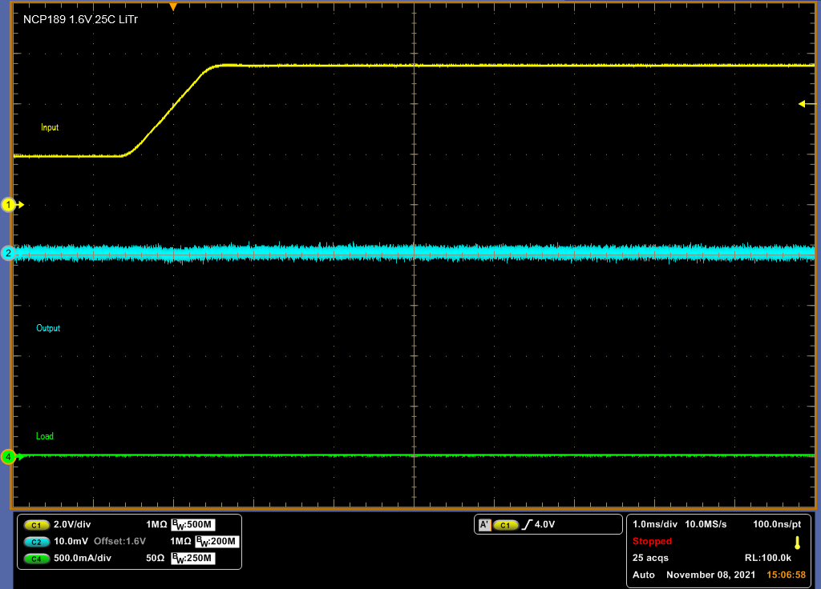
NCP189 / NCV8189 / NCx59801 - line regulation
Option: 1V6
2V to 5.5V
Iout = 0mA
Cout = 4.7uF
Ta = 25°C

Slide 16
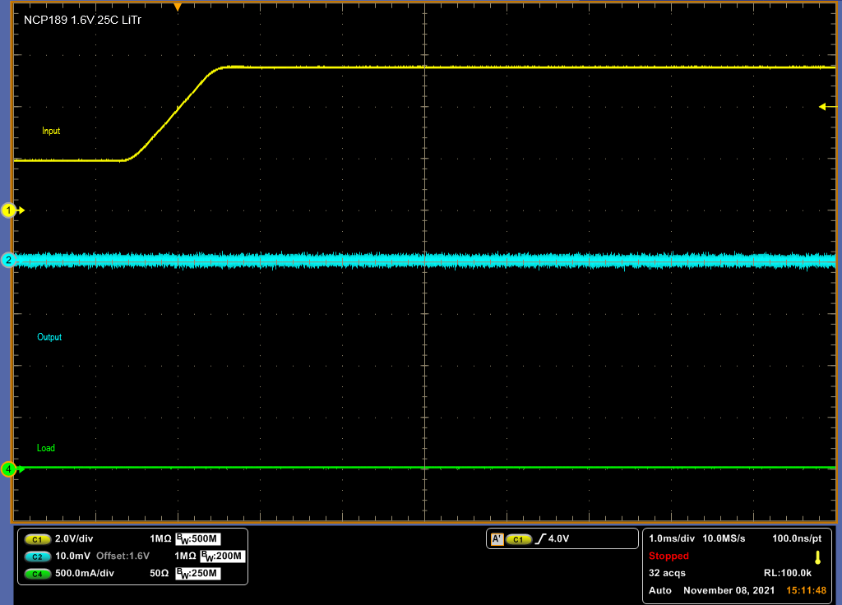
NCP189 / NCV8189 / NCx59801 - line regulation
Option: 1V6
2V to 5.5V
Iout = 1mA
Cout = 4.7uF
Ta = 25°C

Slide 17
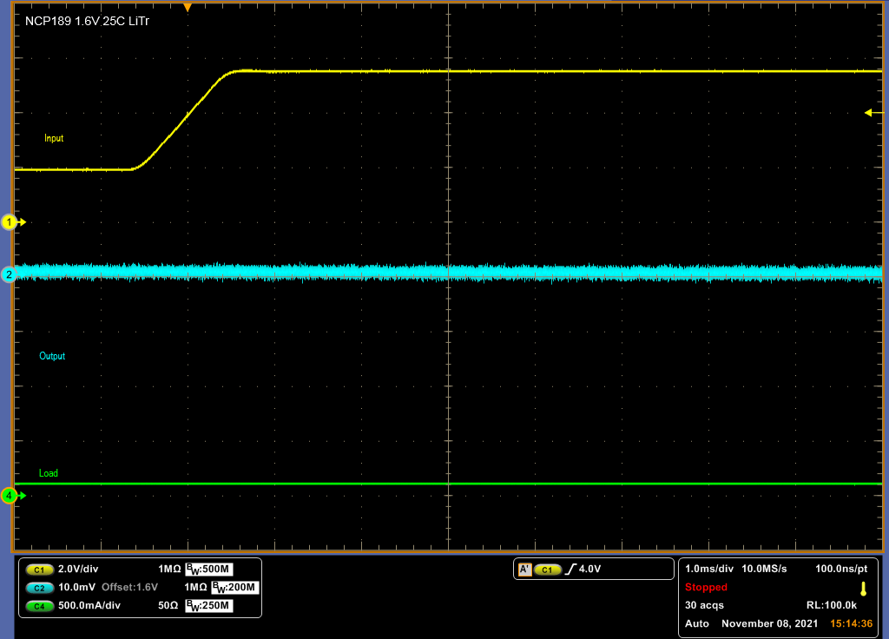
NCP189 / NCV8189 / NCx59801 - line regulation
Option: 1V6
2V to 5.5V
Iout = 100mA
Cout = 4.7uF
Ta = 25°C

Slide 18
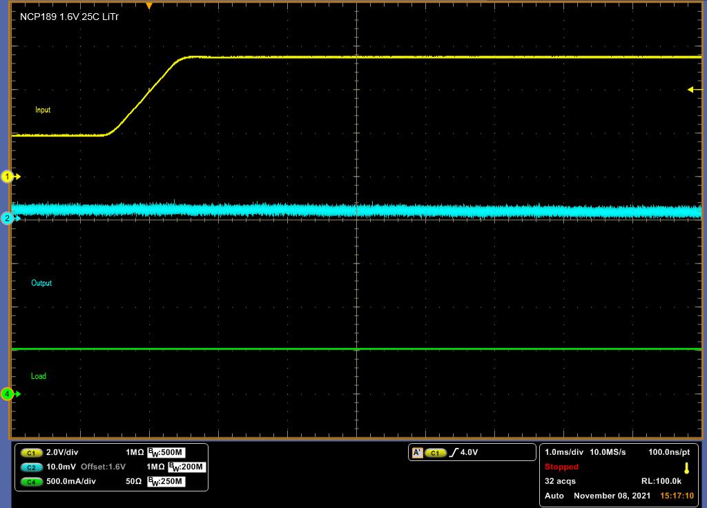
NCP189 / NCV8189 / NCx59801 - line regulation
Option: 1V6
2V to 5.5V
Iout = 500mA
Cout = 4.7uF
Ta = 25°C

Slide 19
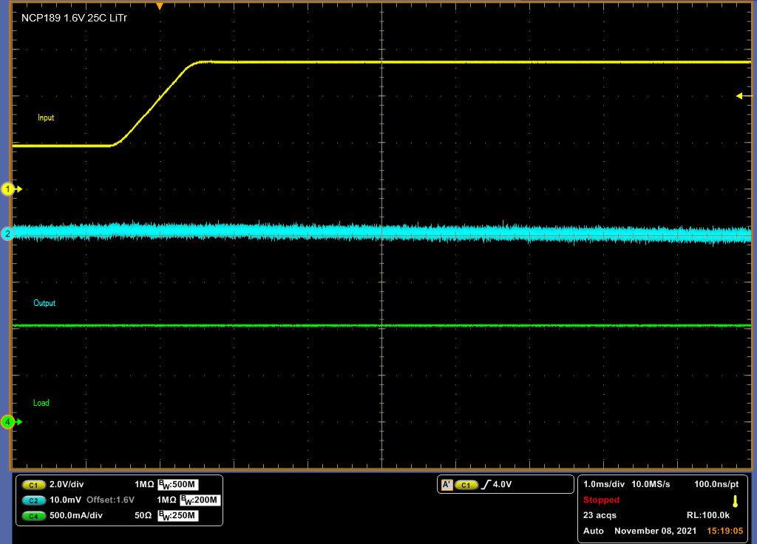
NCP189 / NCV8189 / NCx59801 - line regulation
Option: 1V6
2V to 5.5V
Iout = 1000mA
Cout = 4.7uF
Ta = 25°C

Slide 20
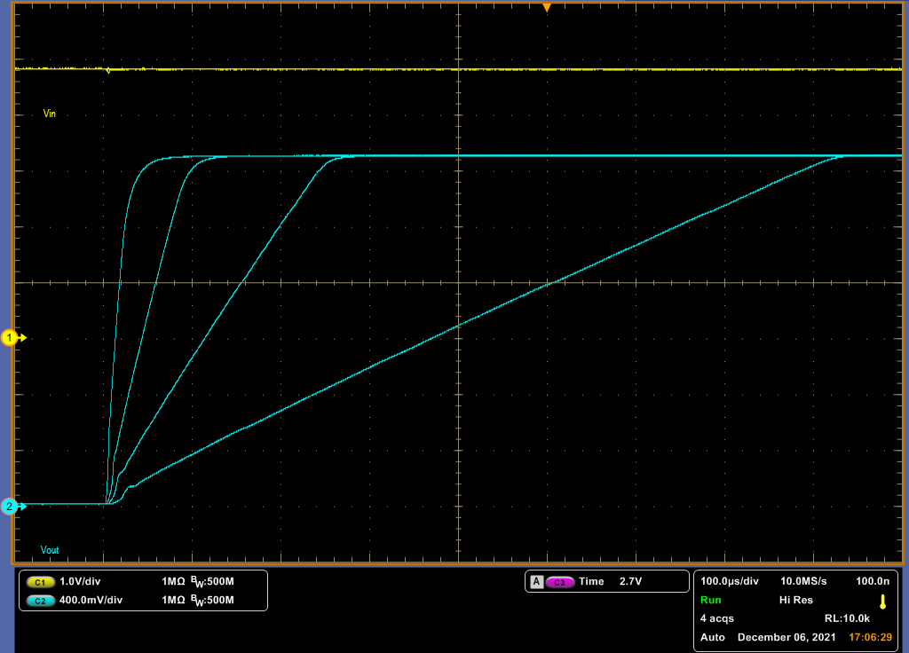
NCP189 / NCV8189 / NCx59801 - soft start (slew rate)
Option: 2V5
All options
Iout = 1mA
Cout = 4.7uF
Ta = 25°C

Slide 21
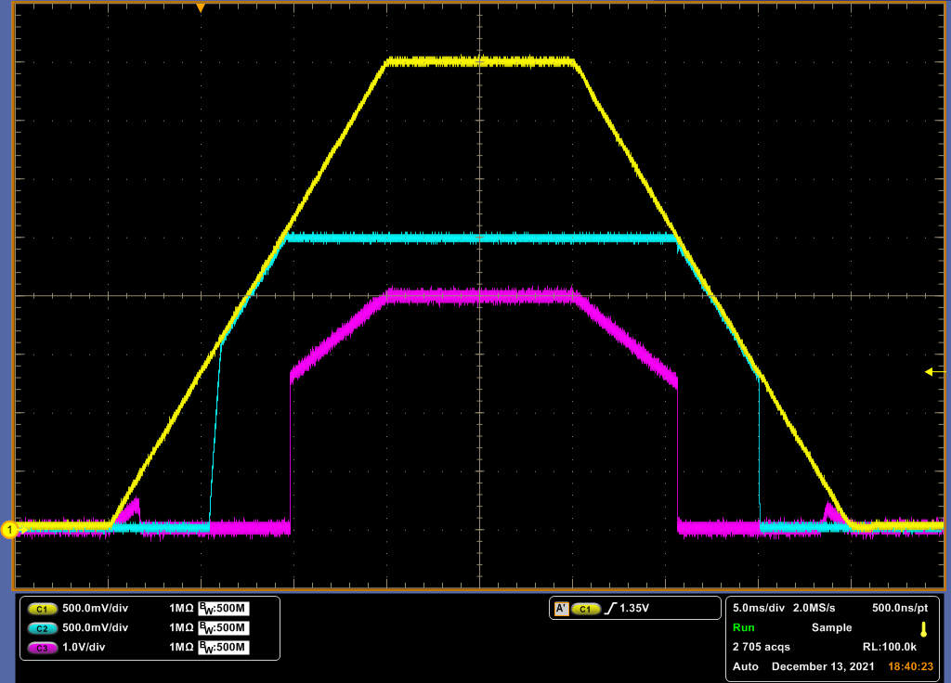
NCP189 / NCV8189 / NCx59801 - start-up
Option: 2V5
Iout = 10mA
Cout = 4.7uF
Ta = 25°C

Slide 22
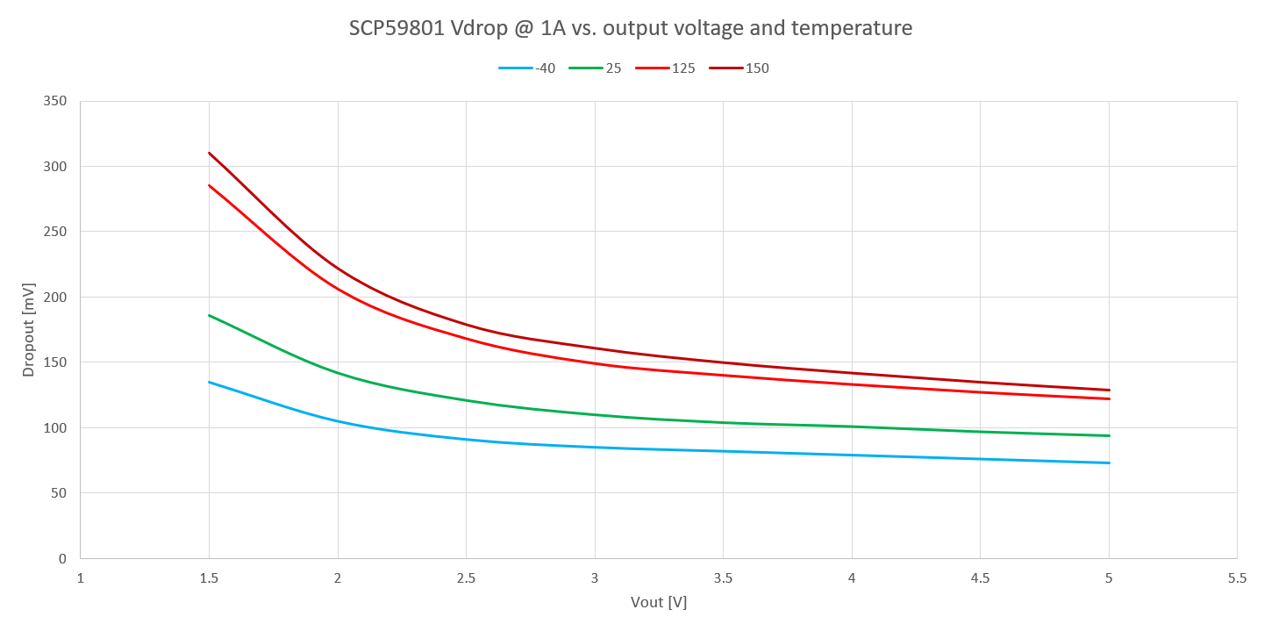
NCP189 / NCV8189 / NCx59801 – dropout

Slide 23
PSRR

Slide 24

For more technical details please contact marek.bek@onsemi.com
Internal Use Only © onsemi 2021

